Slide 1

Electric Vehicle Data Analysis
Name: Jarupla Pooja
Batch No: 536

Slide 2
About Me
• Background: I completed my B.E in Stanley College of Engineering and Technology for Women in the stream of Information Technology,2026.
• Why I want to learn Data Analytics: Aspiring Data Analyst passionate about exploring data, identifying trends, and solving problems. Learning Python, SQL, Excel, and Power BI to generate meaningful insights and support data-driven decisions.
• Work Experience: Fresher
• LinkedIn Profile: https://www.linkedin.com/in/jarupla-pooja-46ab95282/
• GitHub Profile: https://github.com/Jarupla-Pooja
02

Slide 3
1.Business Problem
2.Project Objectives
3.Dataset Overview
4. Project introduction
Tools and Technologies Used
Data Cleaning and Preprocessing
Exploratory Data Analysis (EDA)
Key Insights and Findings
Conclusion and Future Scope
Agenda
02

Slide 4
Project Introduction
Electric Vehicles (EVs) are becoming increasingly popular in the automotive industry.
EVs offer an alternative to traditional fuel-powered vehicles.
This project focuses on collecting EV-related data from websites using web scraping.
Python is used to extract and organize relevant information from web pages.
The collected data includes important vehicle specifications and features.
Data cleaning is performed to handle missing values and inconsistencies.
Exploratory Data Analysis (EDA) is used to understand the dataset.
Charts and visualizations help identify patterns and trends in EV data.
The analysis helps compare different electric vehicles based on available attributes.
02

Slide 5
Project Overview
Business problem
The growing adoption of electric vehicles creates a need to understand EV market trends, vehicle specifications, and battery performance. This project uses web scraping and data analysis to collect, clean, and analyze EV data to identify useful insights and support informed decision-making.
Project objective
Collect EV data using web scraping techniques.
Clean and preprocess the collected dataset.
Analyze EV specifications, pricing, and performance.
Identify trends and patterns through data visualization.
Generate meaningful insights to support data-driven decisions.
02

Slide 6
Dataset Overview
Dataset Name: EV Data Scraping & EDA
Data Source: EV Database — https://ev-database.org/
Source File: web-EDA- Projectt. ipynb
Data Collection Method: Web Scraping using Python
Original Dataset Size: 1,493 rows and 14 columns
Data Type: Structured Electric Vehicle data
Key Attributes: Brand, Model, Price, Battery Capacity, Driving Range, Energy Consumption, and Charging Power
Data Preprocessing: Missing values handled using median imputation
02

Slide 7
Tools And Technologies Used
Python: Main programming language used for data analysis.
Jupyter Notebook: Interactive environment used to write and execute Python code.
Pandas: Used for data loading, cleaning, manipulation, and statistical analysis.
NumPy: Used for numerical operations and handling missing values.
Matplotlib: Used to create charts and visualizations.
Seaborn: Used to create statistical plots and explore relationships between variables.
Techniques Used
Data Cleaning and Preprocessing
Missing Value Handling
Duplicate Removal
Feature Engineering
Descriptive Statistical Analysis
Exploratory Data Analysis (EDA)
Data Visualization
02

Slide 8
Data Cleaning & Preparation
Data Inspection: Checked the scraped EV dataset to understand its structure and columns.
Duplicate Check: Identified duplicate records in the dataset.
Missing Values: Checked for missing or null values in important columns.
Data Formatting: Organized vehicle details into a structured tabular format.
Data Type Checking: Reviewed data types for price, battery capacity, driving range, and charging power.
Text Cleaning: Standardized brand and model names where required.
Data Validation: Checked extracted values for inconsistencies and invalid entries.
Data Preparation: Prepared the cleaned dataset for Exploratory Data Analysis (EDA).

Slide 9
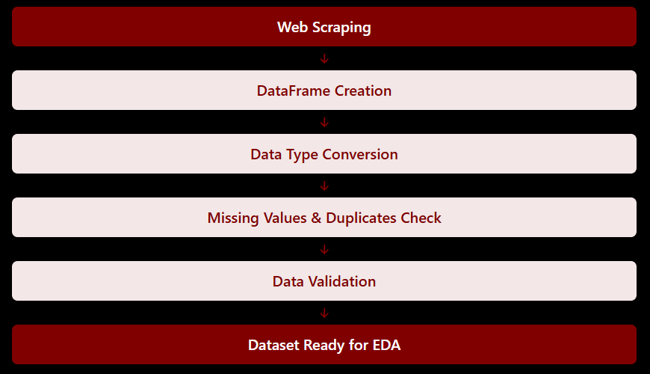
Work Flow:

Slide 10
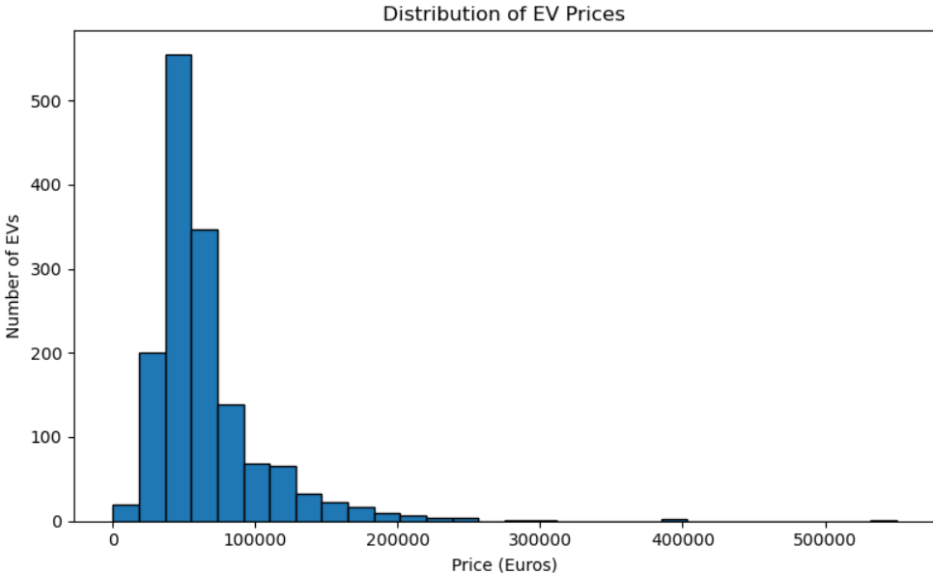
Univariate Analysis
Ev-Price Distribution
1. EV Price Distribution — Histogram
Variable: Price (€)
Purpose: To understand the distribution of electric vehicle prices across the scraped EV dataset.
Description: The histogram shows how many electric vehicles fall within different price ranges. It helps identify common price ranges, understand price variation, and observe whether expensive vehicles create a right-skewed distribution.
Key Statistic: Mean price is €65,108.54, while median price is €53,990.
Hyderabad House Rental Market Analysis
02

Slide 11
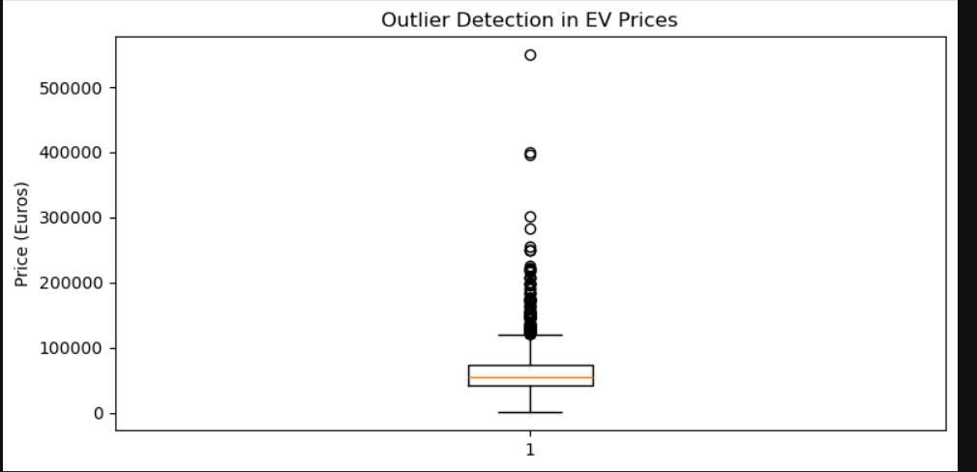
Univariate Analysis
Outlier Detection in Ev Prices
2. Outlier Detection in EV Prices — Box Plot
Variable: Price_Euros
Purpose: To identify outliers and understand the spread of electric vehicle prices.
Description: The box plot displays the median, quartiles, and overall price variation. Points beyond the whiskers indicate potential outliers, helping identify unusually low or high EV prices.
Key Statistic: Mean price is €65,108.54, while the median price is €53,990.
Hyderabad House Rental Market Analysis
02

Slide 12
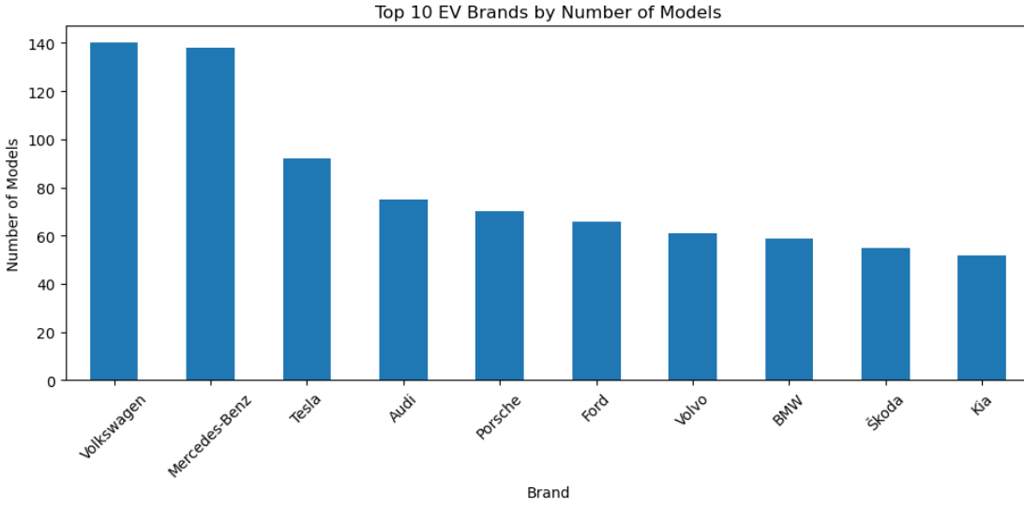
Univariate Analysis
Brands
3. Top 10 EV Brands by Number of Models — Bar Chart
Variable: Brand
Purpose: To identify the top 10 electric vehicle brands based on the number of models available.
Description: The bar chart displays the top 10 EV brands with the highest number of models. Each bar represents a brand, and its height indicates the total number of models offered by that brand.
Key Insight: The chart helps identify which EV brands have the widest
model availability and which manufacturers have a stronger presence in the electric vehicle market.

Slide 13
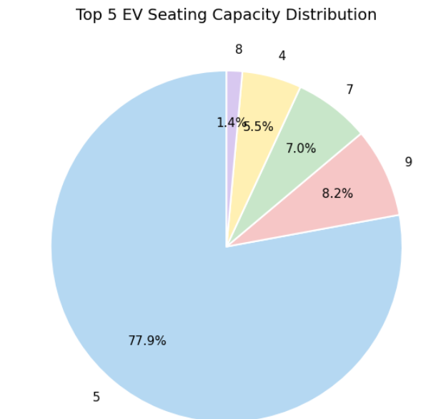
Univariate Analysis
Seating Capacity
4. Top 5 EV Seating Capacity Distribution — Pie Chart
Variable: Number_of_Seats
Purpose: To understand the distribution of electric vehicles based on their seating capacity and identify
the most common seating categories.
Description: The pie chart displays the top 5 most common seating capacity categories among electric
vehicles. Each slice represents a seating category, and its size indicates the percentage of EV models belonging to that category.
Key Insight: The chart helps identify the most popular seating configurations in the EV market and
understand customer-oriented vehicle design preferences.

Slide 14
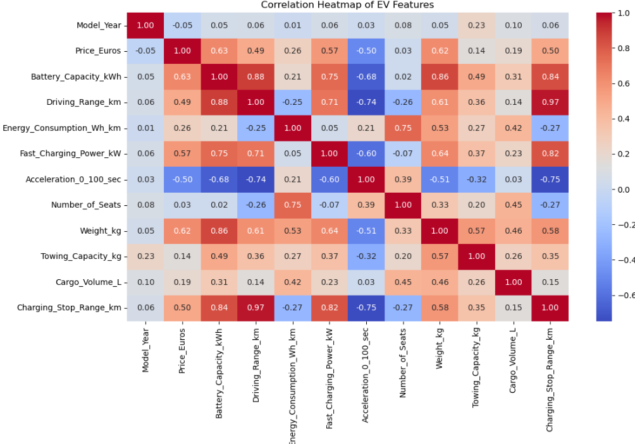
Multi-variate Analysis
7. Correlation Heatmap of EV Features —Heatmap
Variables: All numerical columns in the dataset,
such as Battery_Capacity_kWh, Driving_Range_km, Price_Euros,
Top_Speed_kmh, and other numerical features.
Purpose: To identify the correlation between different
numerical features of electric vehicles and understand how they
are related to each other.
Description: The correlation heatmap represents the relationships
between numerical EV features using different colors and correlation values.
The values range from -1 to +1, where +1 indicates a strong positive correlation, -1 indicates a strong negative correlation, and 0 indicates little or no linear correlation.
Key Insight: The heatmap helps identify which EV features are strongly related,
such as battery capacity and driving range, and highlights patterns that can
support further analysis.

Slide 15
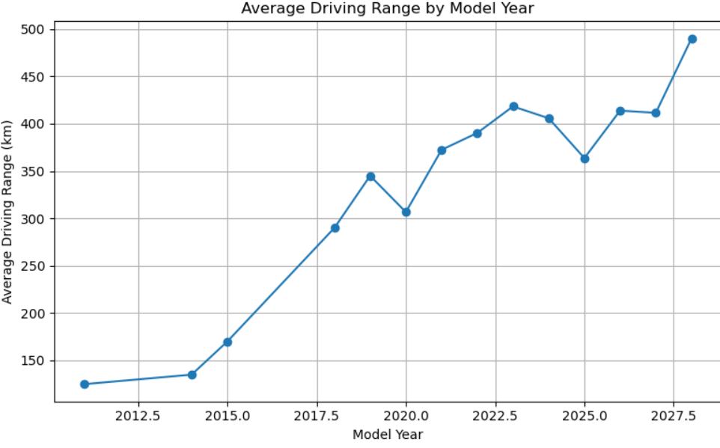
Bi-variate Analysis
Average Driving Range
3.Average EV Driving Range by Model Year
Variables: model_year and real_range_km
Purpose: To understand how the average driving range of electric vehicles varies across model years.
Description: The line chart displays the average real-world driving range of EVs for each model year. It helps identify changes and trends in driving range over time.
Key Observation: The chart helps show whether the average driving range increases or decreases across model years.
Hyderabad House Rental Market Analysis
02

Slide 16
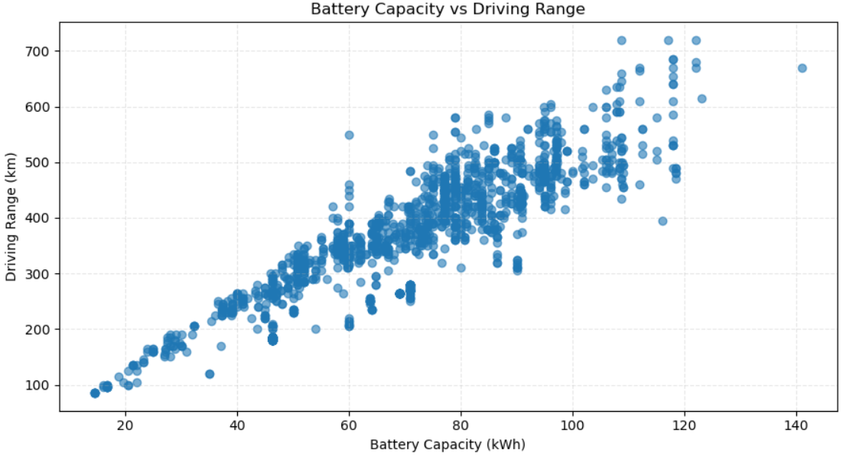
Bi variate Analysis
Battery Capacity vs Range
4. Battery Capacity vs Driving Range — Scatter Plot
Variables: Battery_Capacity_kWh, Driving_Range_km
Purpose: To analyze the relationship between battery capacity and driving range of electric vehicles.
Description: The scatter plot displays battery capacity against driving range, where each point represents an electric vehicle. It helps identify the relationship between battery size and the distance an EV can travel.
Key Insight: EVs with higher battery capacity generally tend to have a longer driving range, although vehicle efficiency and other specifications can also influence the range.
Hyderabad House Rental Market Analysis
02

Slide 17
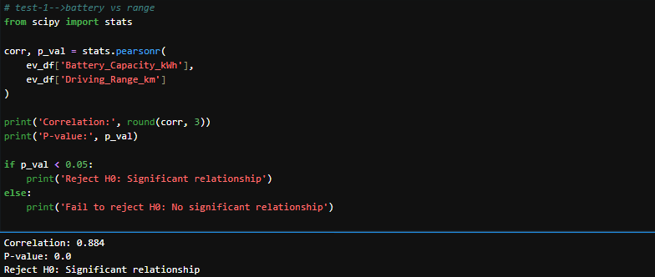
Hypothesis-1
H₀ (Null Hypothesis): There is no significant relationship between battery capacity and driving range.
H₁ (Alternative Hypothesis): There is a significant relationship between battery capacity and driving range.

Slide 18
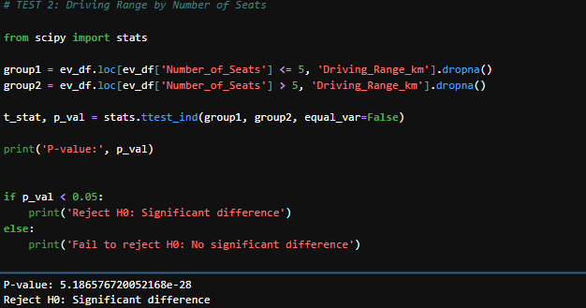
Hypothesis-2
H₀ (Null Hypothesis): There is no significant difference in the average driving range between the
two seating groups.
H₁ (Alternative Hypothesis): There is a significant difference in the average driving range between the two
seating groups.
Key Insight: This test helps understand whether EV seating capacity is associated with differences in
average driving range.

Slide 19
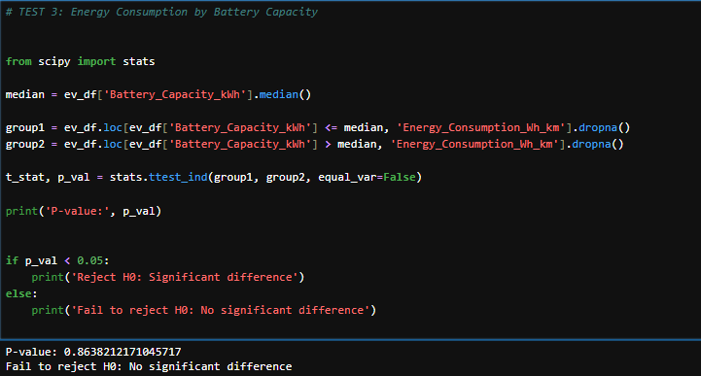
Hypothesis-3
H₀ (Null Hypothesis): There is no significant difference in average energy consumption between the two
battery capacity groups.
H₁ (Alternative Hypothesis): There is a significant difference in average energy consumption between the
two battery capacity groups.

Slide 20
Key Insights
Web Scraping: Collected EV data using Python.
Data Cleaning: Handled missing values and duplicate records.
Price Analysis: Average EV price is higher than the median due to expensive models.
Outlier Detection: Identified unusually high and low EV prices.
Brand Analysis: Compared EV brands based on model availability.
Seating Analysis: Studied the distribution of EV seating capacities.
Bivariate Analysis: Examined driving range across model years.
Correlation Analysis: Higher battery capacity is strongly associated with longer driving range.
Hypothesis Testing: Tested relationships between battery capacity, driving range, seating capacity, and energy consumption.
Overall Finding: EV models differ in price, range, and performance.

Slide 21
Conclusion
This project involved collecting EV data through web scraping using Python, followed by data cleaning and preprocessing to handle missing values and duplicate records.
EDA techniques, including univariate, bivariate, and multivariate analysis, were used to study EV prices, outliers, brand availability, seating capacity, and driving range. Correlation analysis showed a strong positive relationship between battery capacity and driving range.
Three hypothesis tests examined the relationship between battery capacity and driving range, differences in driving range between seating groups, and differences in energy consumption between battery capacity groups. The results showed statistically significant relationships or differences in all three tests.
Future Scope: The project can be extended by using machine learning to predict EV prices and driving range and Power BI to create interactive dashboards.

Slide 22
Q & A
Hyderabad House Rental Market Analysis
09

Slide 23
THANK YOU
Hyderabad House Rental Market Analysis
09

